Slide 1
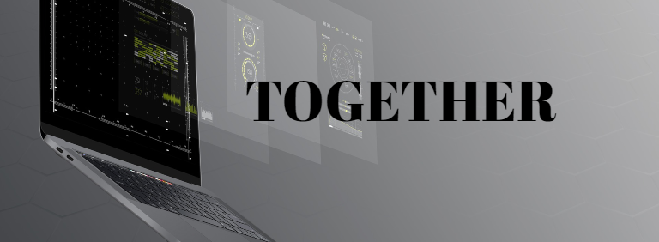
Generic Smartphone Game Controller
Bachelor Thesis
Flückiger Quentin
Notes:
Welcome to presentation of bachelor thesis.
The topic I chose is Generic ….
And I will start this presentation with a little story.
CHANGE PICTURE / TOGETHER ???
Font together more game like
Use more space (right)
Use together picture

Slide 2
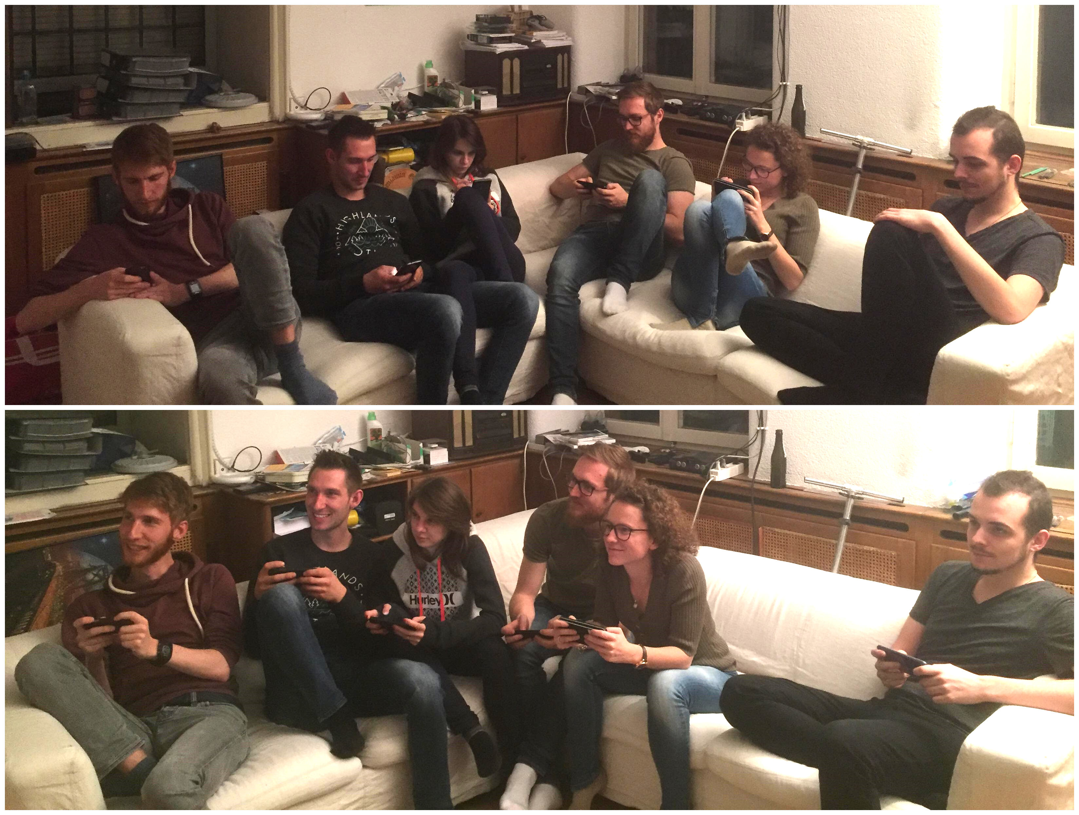
Example of playing on their side and then Together
Notes:
I think those numbers don’t surprise anyone as very often we see on the streets, in buses, trains, pretty much everywhere, people playing on their smartphone.
Even though those games might be good, they tend to isolate people and make them play in their corner. But what if we would make them play together.
Make picture bigger, Talk about the POINT of together
Is there a market for it ? Make it dramatic

Slide 3
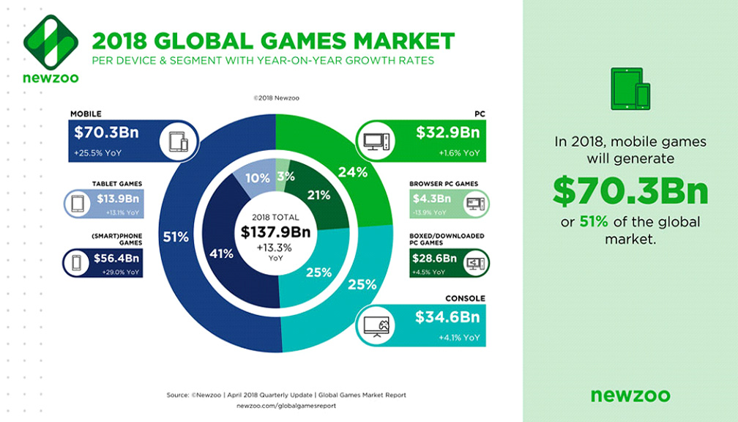
Device based comparison
Notes:
And if we look more in detail the income generated by the gaming market we can see that a solid 50% of it comes from mobile games.
Too much info clear center, let smartphone / rest

Slide 4
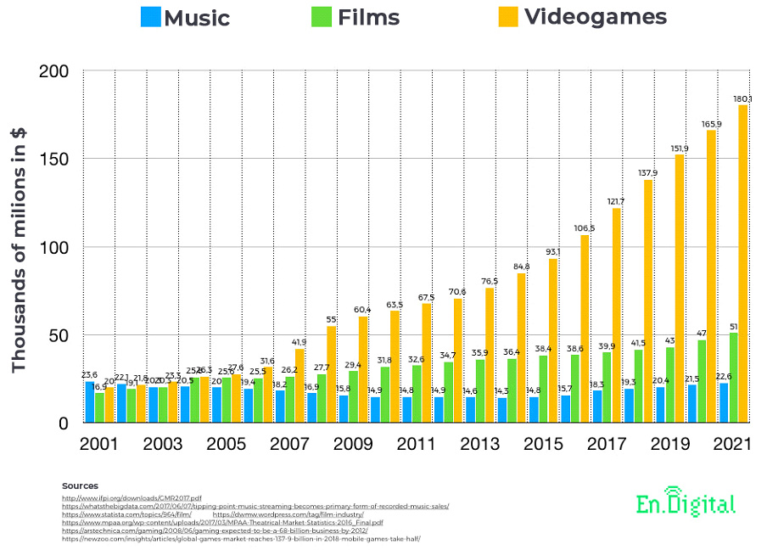
Revenue comparison
Notes:
Nowadays the gaming industry is very lucrative and has a huge part of the market in digital entertainement.
As you can see on this chart comparing Music, Movies (TV-Show not included) and videogames.
Make it bigger, put sources at end

Slide 5
Table of content
Goals
Games
Controllers
Demo
Conclusion
Question(s)
Sources
Notes:
delete

Slide 6
Goals
Use smartphones as A SMART controller for video games played on computer
Multiplayer games
Generic platform
Notes:
But what where actually my goals ?
The main goal was to create a platform which would use smartphones as controllers and a computer screen as the palce where the game is playing.
It had to be multiplayer.
I wanted to make this platform generic to allow the possibility to implement more easily games for this software.
Make it more interesting, make 3 slides, one for each
Go to next slides delete last image and show new one
Generic image ios/android

Slide 7
Games
Snake Game
1-4 players
Simple rules
Simple controller
Domino Game
2 players
Kind of a card game
Smarter controller
Notes:
Snake game: You play as a little snake whose goal is to eat apple to grow bigger, but be aware of the walls and snake tails. No look at controller.
Domino: You have dominos in your hand, cards with two values, and you need to empty your hand by placing them on the board in turn. Here the smartphone is at the core of the game, and you need to look at it during the game.
Make more slides out of this one, building slides Incremental
Add picture, one game 4 controller
We could use our phone for more than just basic input data, personal information
- one game 2 controller

Slide 8
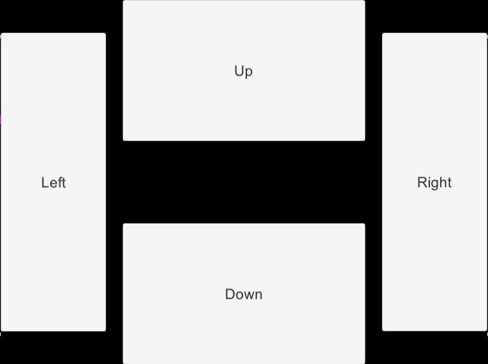
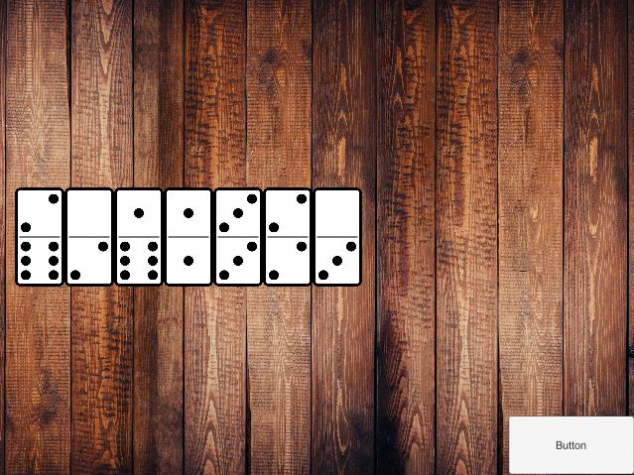
Controllers
Snake Controller
Domino Controller
Notes:
Here you can
Nicer buttons
In case picture of snake
Put somewhere that it is developed with Unity

Slide 9
Demo
Notes:
Ask a friend to play demo with me!!!! Train and test on thursday

Slide 10
Conclusion
Incredible amount of possibilities
Only accessible on the same network
Connecting with IP Adress
Issues with older version of Android
Unity UNeT being deprecated
Notes:
The possibilities using a smartphone as a controller are huge, a game using the motion sensor of the phone could be developed, or the camera, speakers, or something less hardware oriented such as a monopoly.
Accessible only on the same network so everyone has to be connected to the same.
Connecting directly with IP address, can be a bit annoying.
Part of UI element are not rendered, even though they are interactable.
The network technology within unity, which is called UNeT, is being deprecated. (HLAPI & LLAPI) Thus the application will not work after unity 2018.4 and the genericity of the project can not be kept.
Take problems away
Emphasize possibilities (picture)

Slide 11
Framework
Lobby
Generic
Implemented two as examples

Slide 12
Question(s) ?
Notes:
Thank you for your time and attention

Slide 13
Sources
1. https://lpesports.com/e-sports-news/the-video-games-industry-is-bigger-than-hollywood

